Slide 1

Accidents Life Insurance Policy
Case study guide: Sharada. P
Present by:
Sirisha. P
Haritha. B
Ramkumar. D

Slide 2

ABSTRACT:
This Case Study is a Web Application of ABC Ltd, an insurance Company which issues Accidents Life Insurance policies to public using learnt concepts and acquired skills (SQL Server, ASP.NET, ADO.NET, Web Services). The main Scenario of this case study is:
ABC Ltd, an insurance Company issues Accidents Life Insurance policies to public. Under these policies, if the policyholders meet with an accident and suffer injuries, for different types of injuries they pay a certain sum as percentage to the policy amount, obtained by them by paying the applicable premium. In case of death, the amount will be paid to the nominee or legal heir as per the procedure. The claims settlement department maintains the record of all such settlements made and generates a simple statement every month and forwards to its corporate office for consolidation at their end.

Slide 3

Our Project Scope
Scope:
The Scope of this project is to make the insured claimant claim their policy through online website of that respective company with less difficulty of procedures and paperwork.
Future Scope:
This project can still be developed further in the following aspects, such as.,
Two-way-authentication, blocking user if Number of attempts are more

Slide 4

Resources(Hardware & Software):
Environment : Net Framework, Visual Studio Operating System : Windows 10/11
Programming Language : C#/VB
Scripting Language : Java Script
Database : MSSQL Server

Slide 5
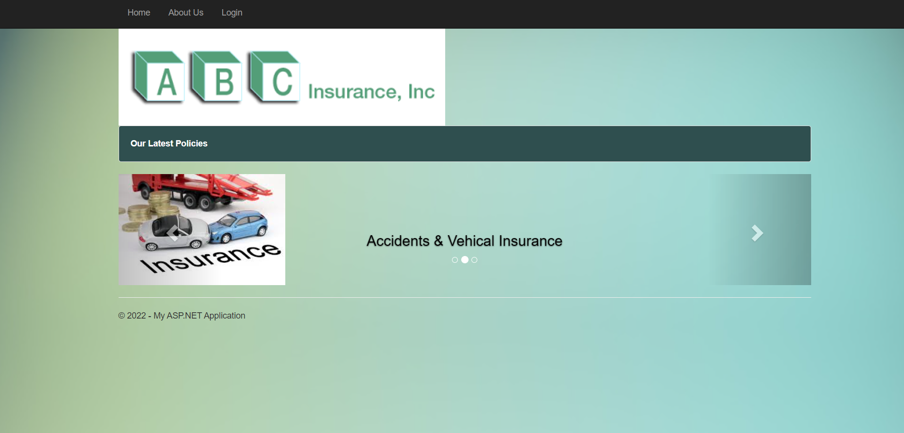
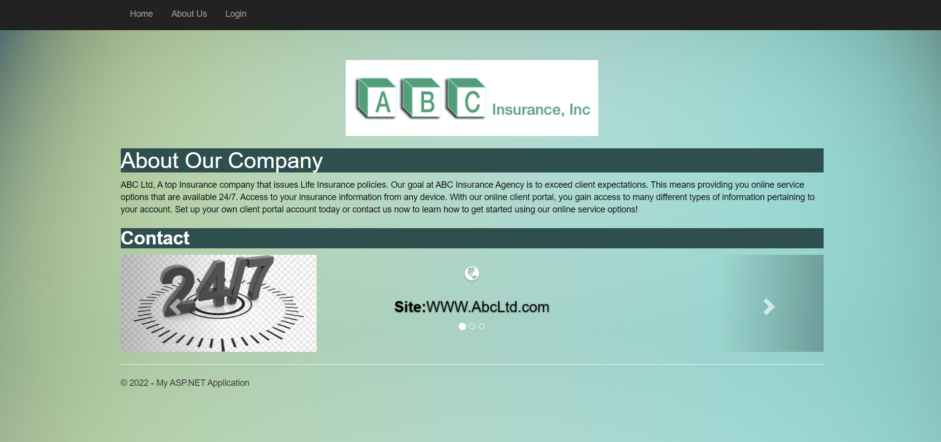
Screens:

Slide 6
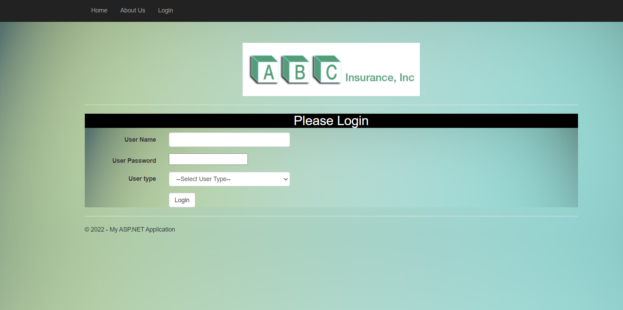
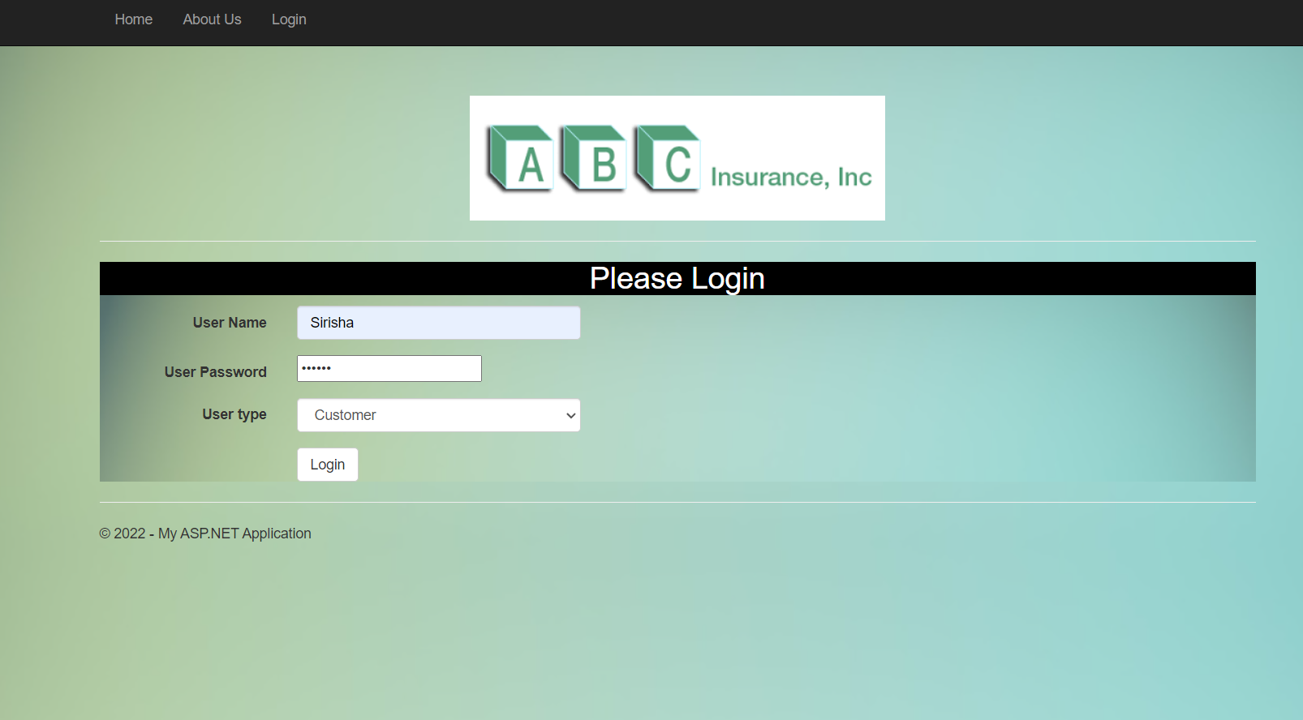

Slide 7
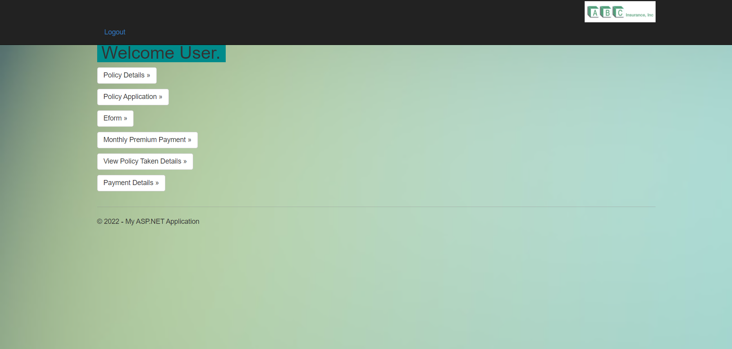
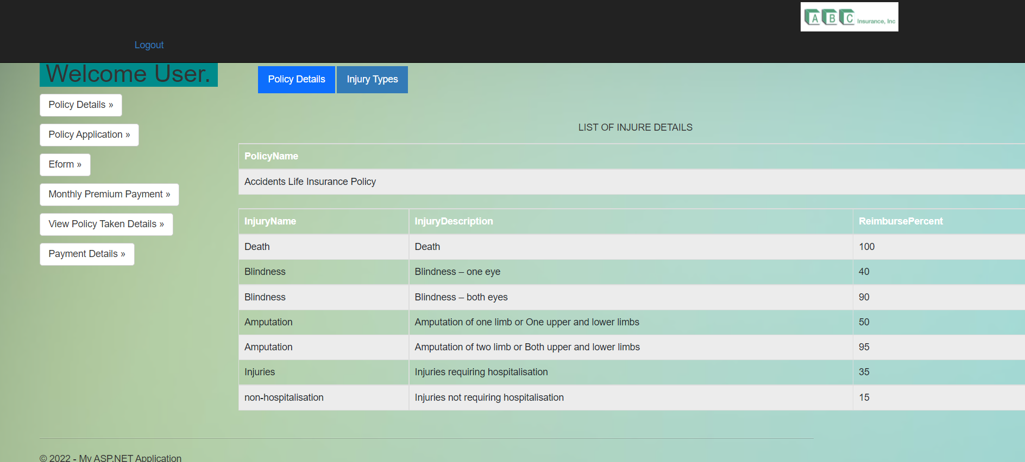
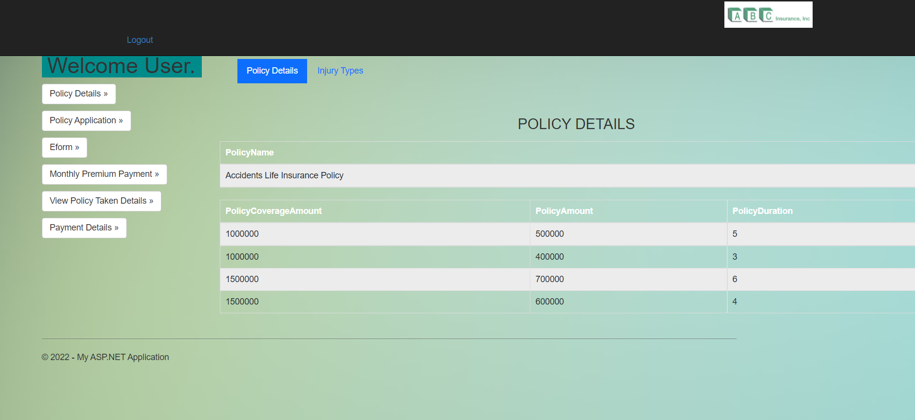
Customer Screens:

Slide 8
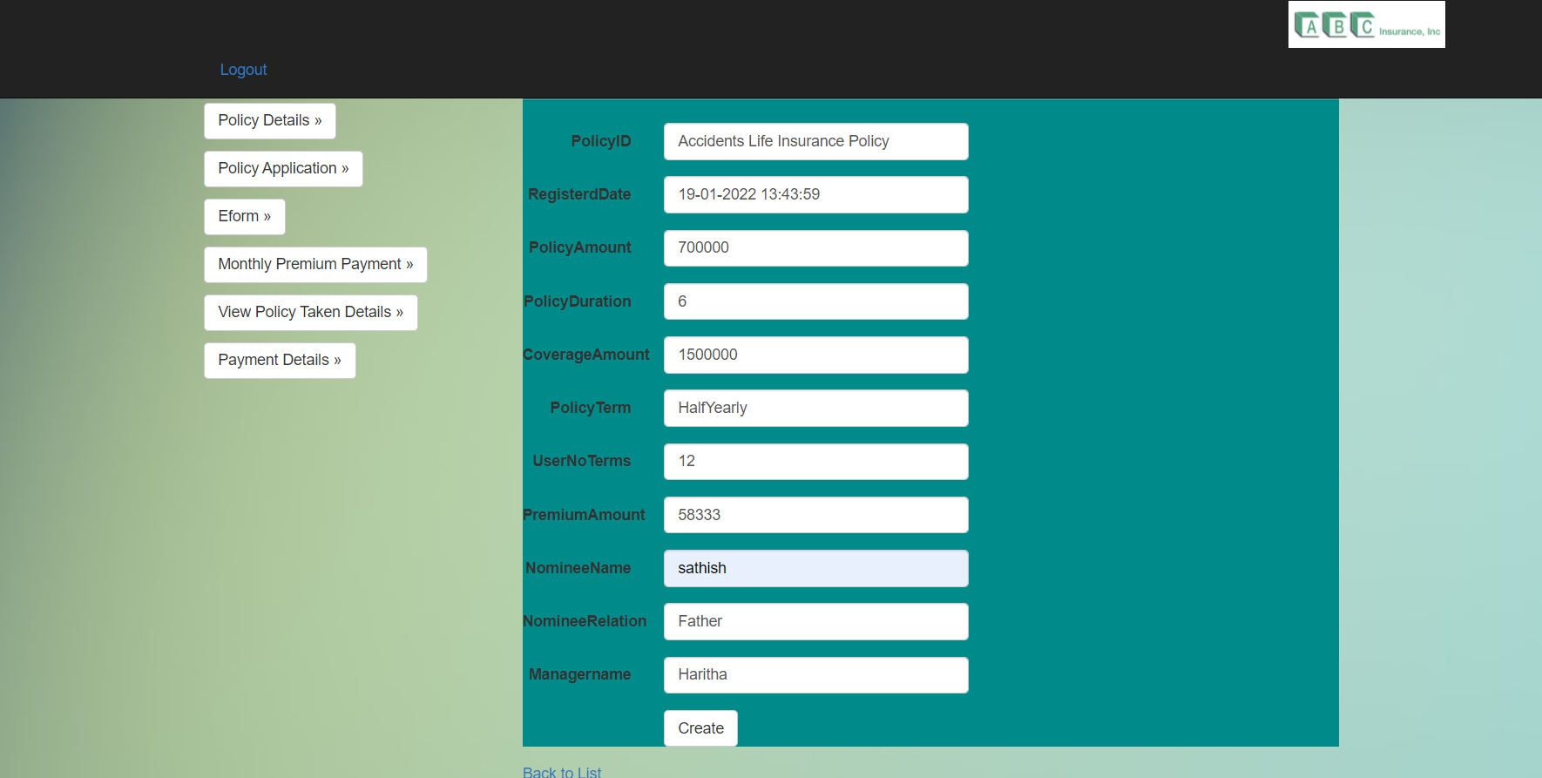
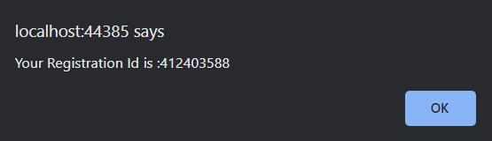

Slide 9
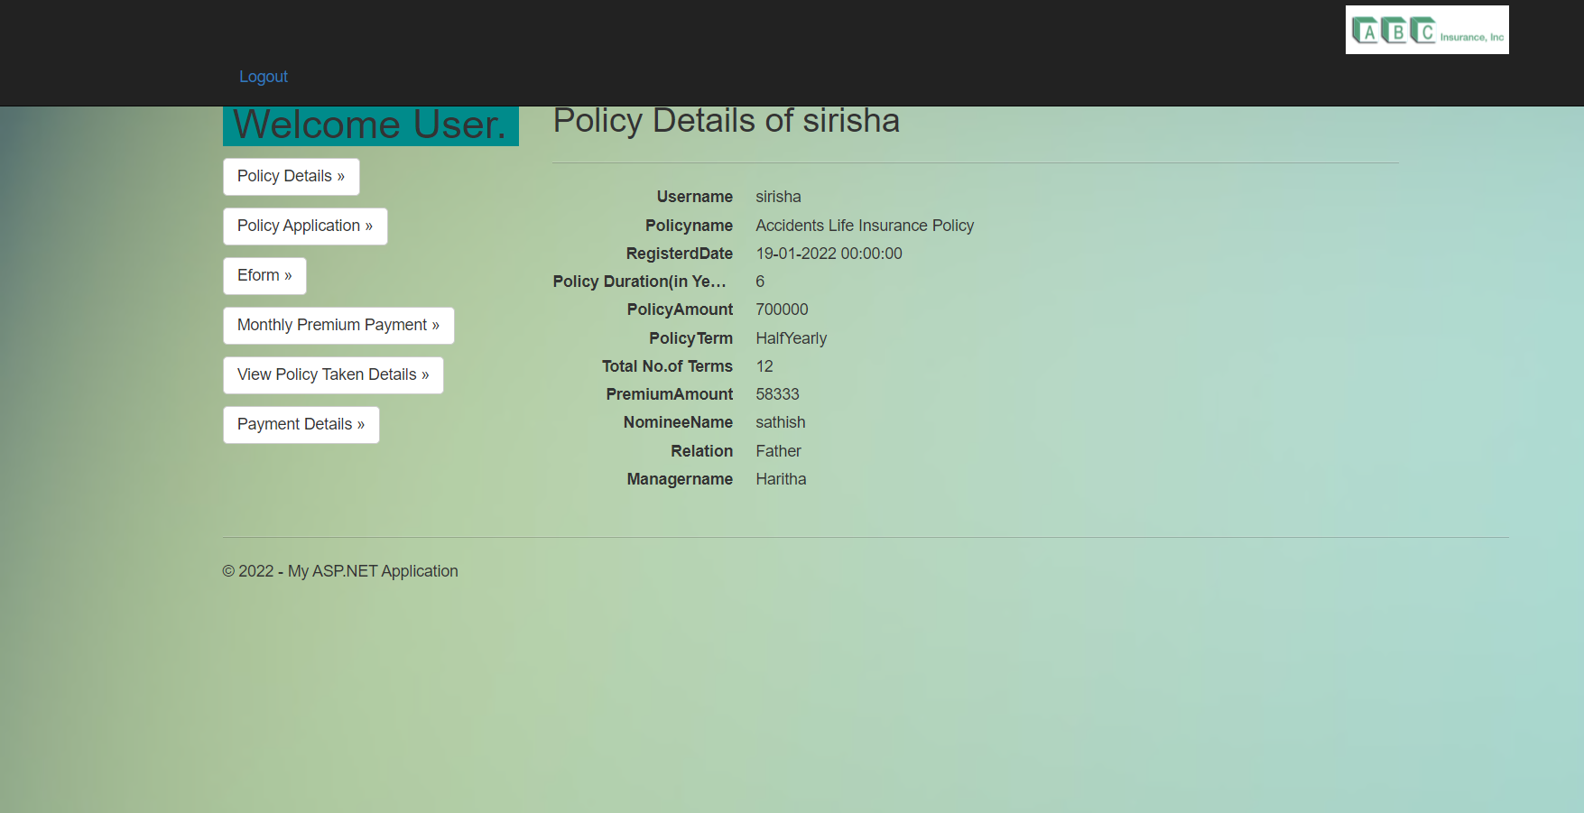
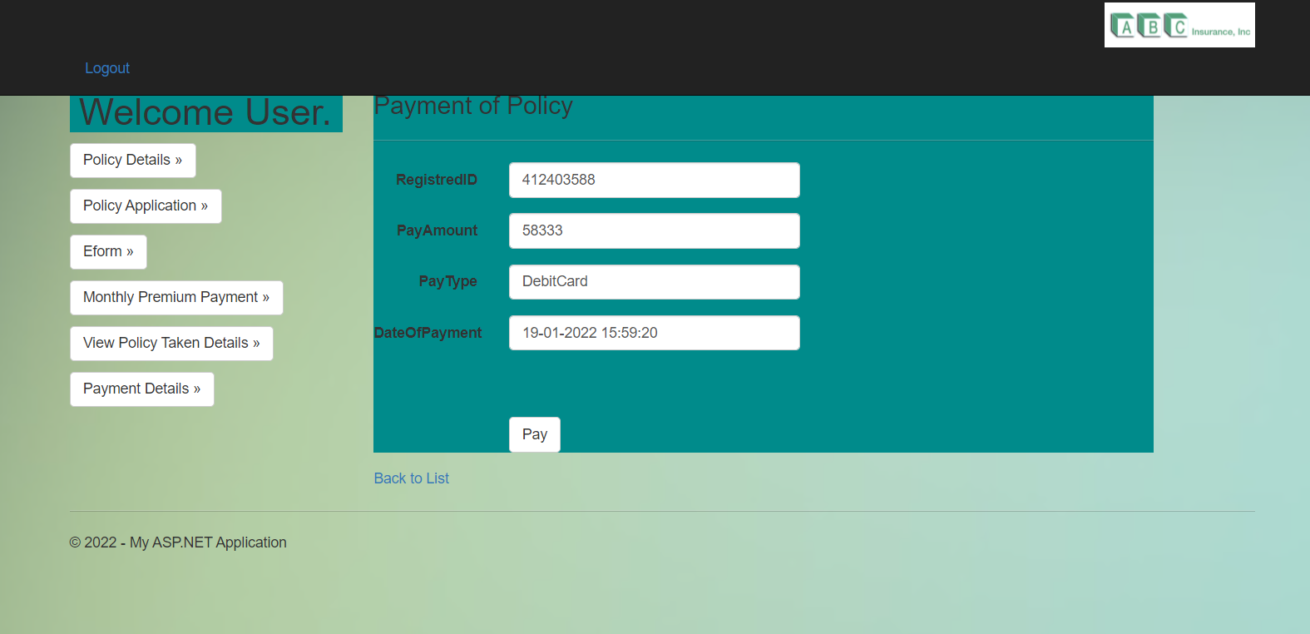
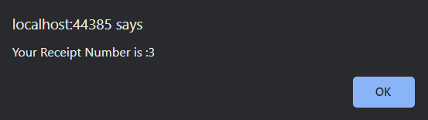

Slide 10
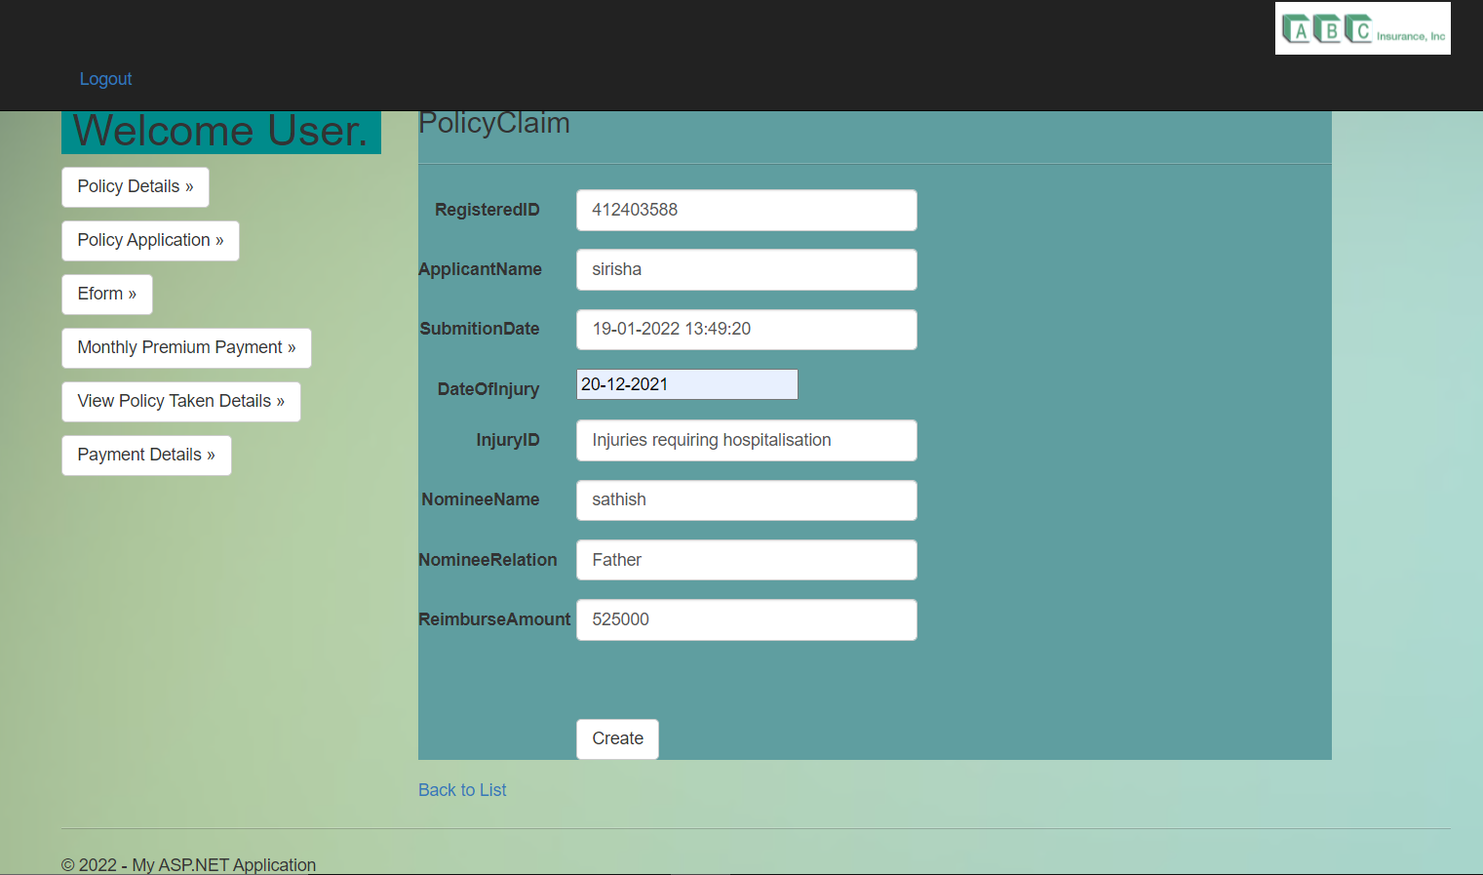
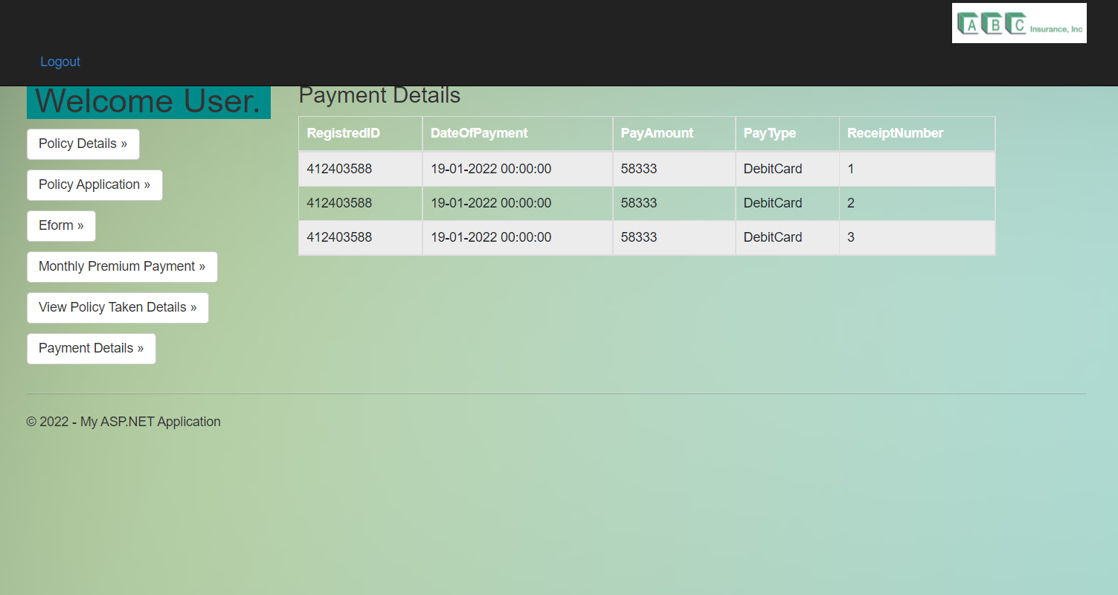

Slide 11
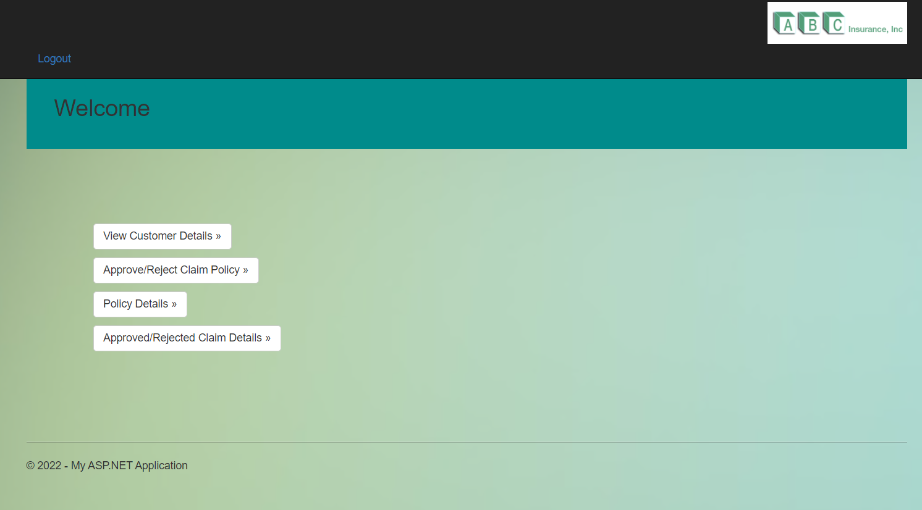
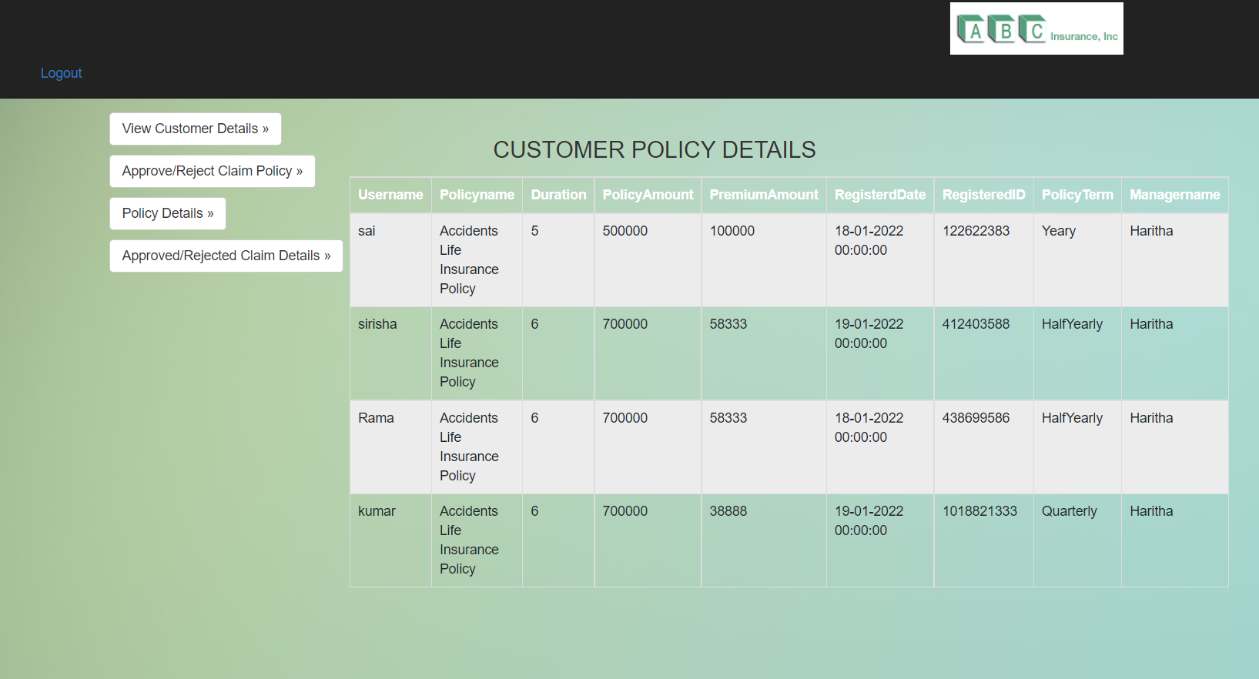
Manager Screen:

Slide 12
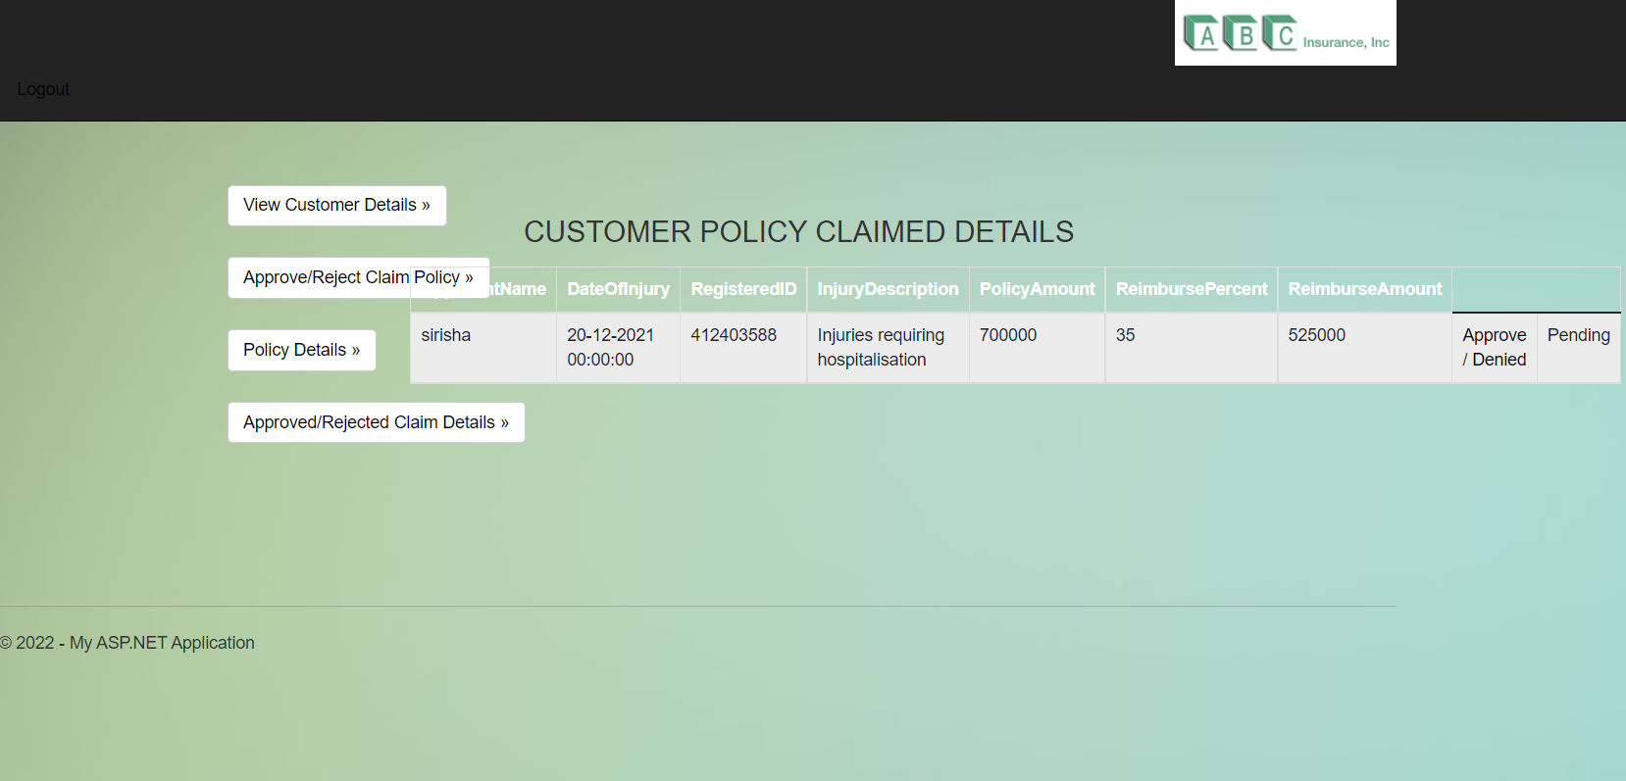
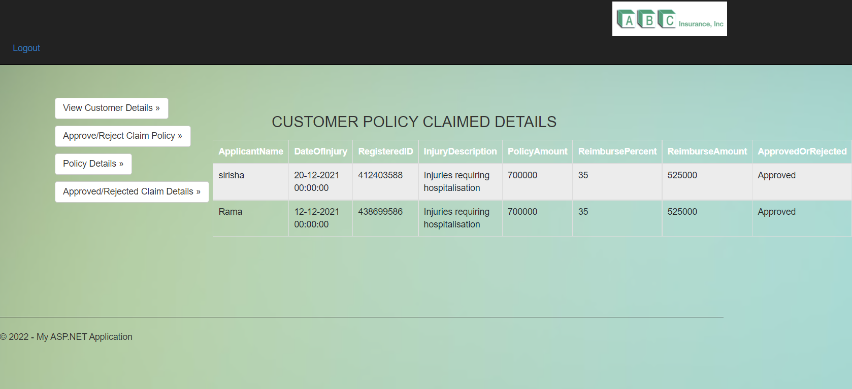

Slide 13
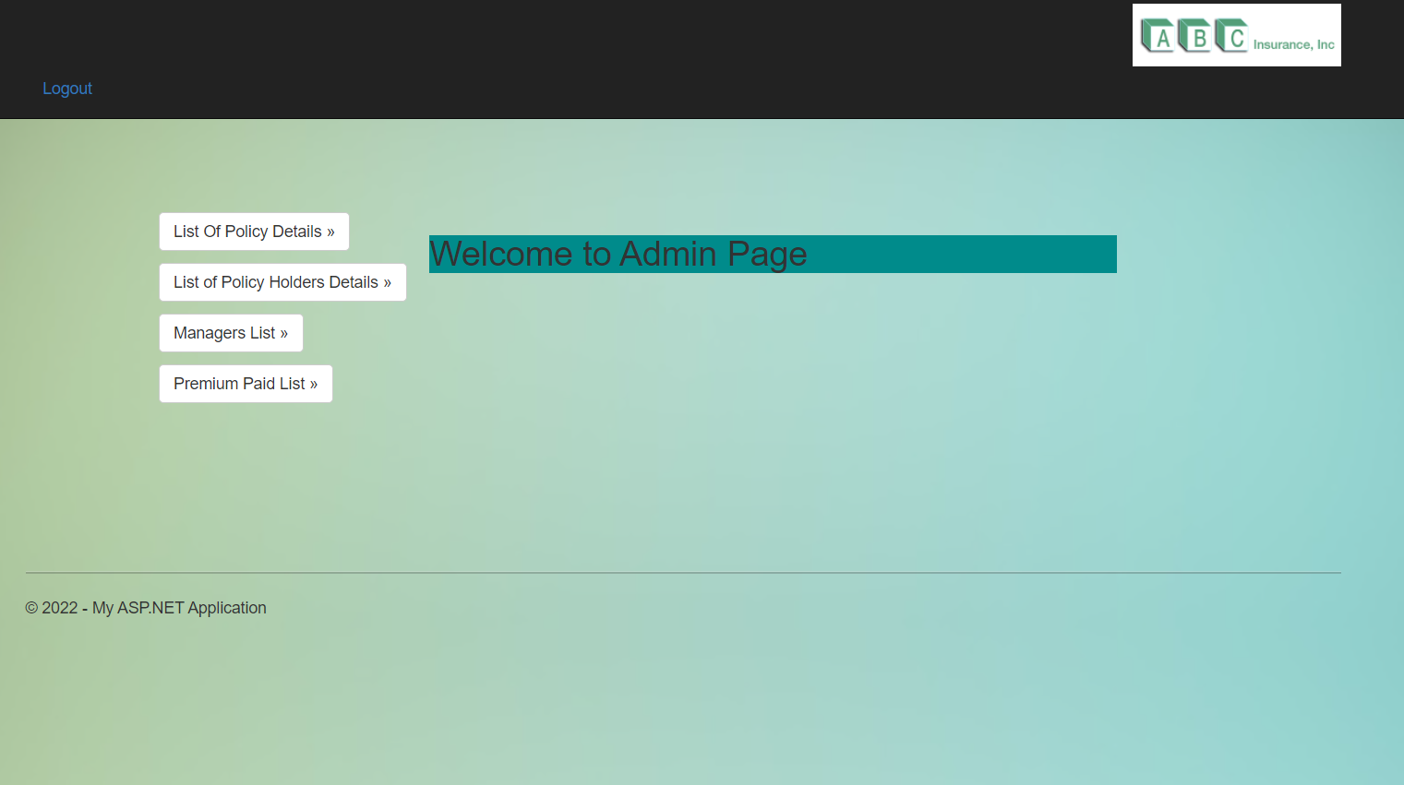
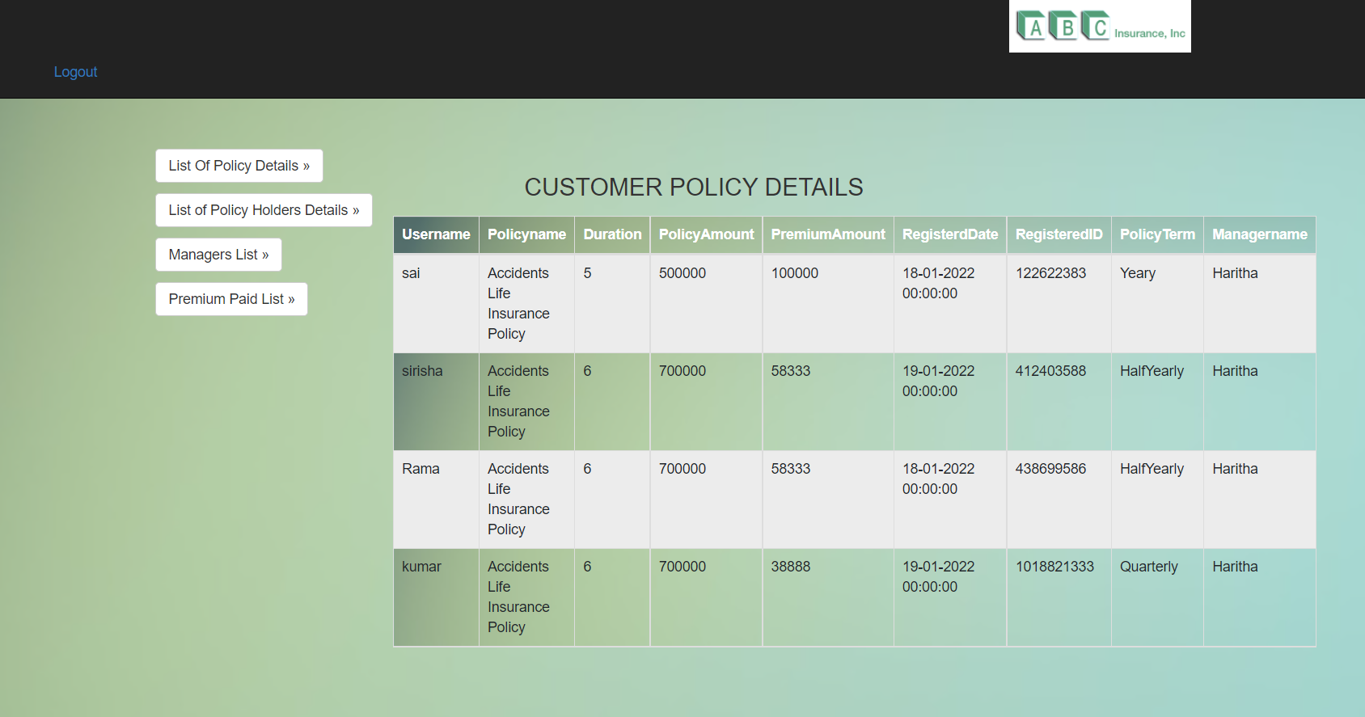
Admin Screens:

Slide 14
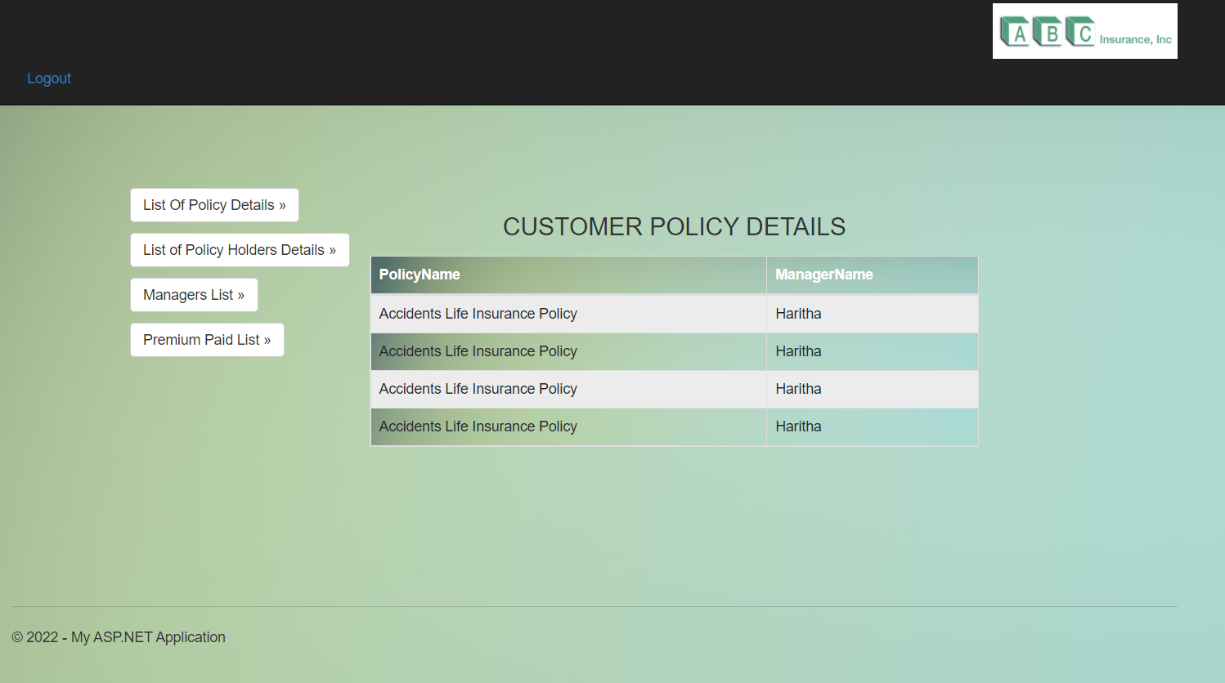
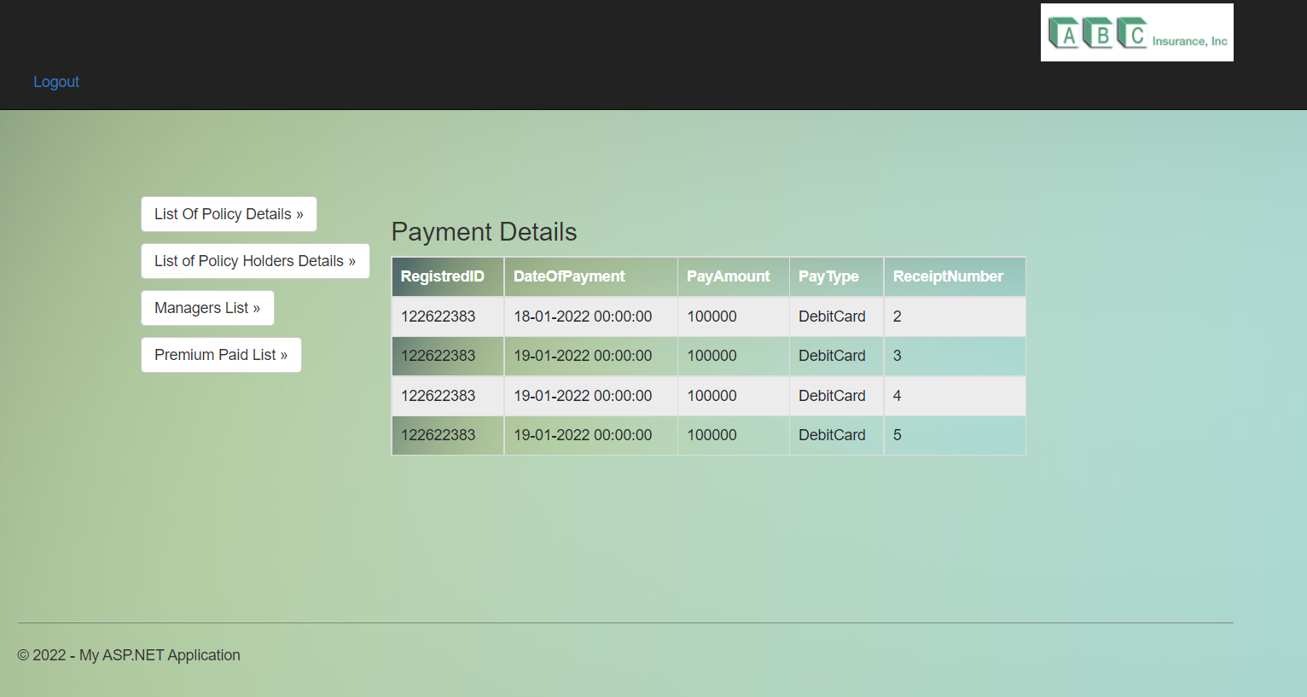

Slide 15
Thank You

